Slide 1
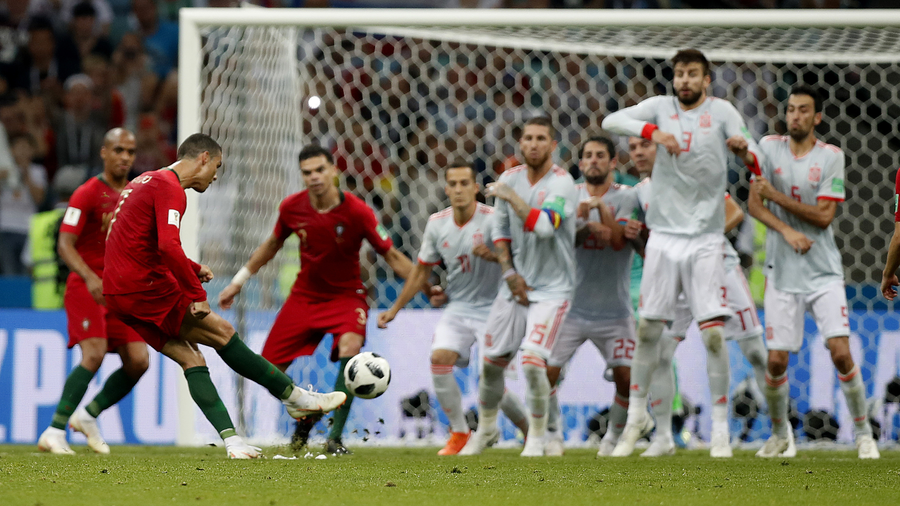
FIFA Player Performance Analyzing
BY PARESHKUMAR SHARMA (185223693104)
DATA SCIENCE PROJECT (PYTHON)

Slide 2

Introduction
FIFA is an international association football competition contested by the senior men's national teams of the members of the Federation International de Football Association (FIFA), the sport's global governing body.
For this project I have selected FIFA 19 complete player dataset that contains all the player’s performance data. After detailed analysis this project, the extracted information will help the football team managers to improve their team performance. This performance is also takes important role to select any team or club or player for the purpose of awarding cup or prizes.

Slide 3
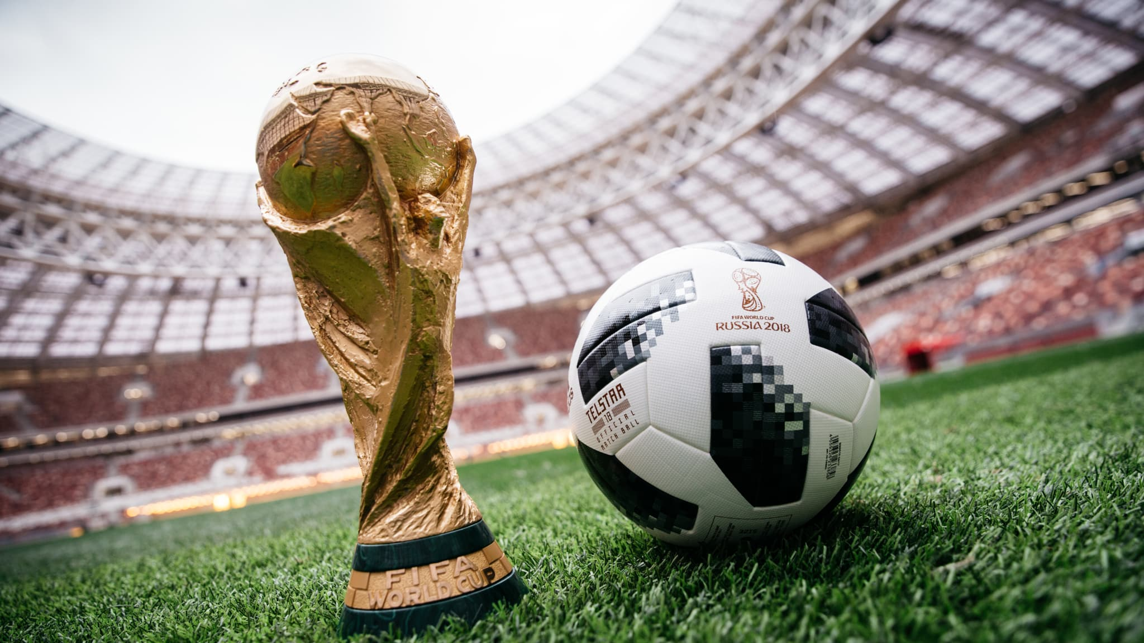
Description
This database contains 88 columns and 18207 rows that contains all player’s performance like nationality, position wise performance, his club, strength etc.
This dataset is use full for football manager and any award giving organization that want to know the top players, top football clubs, and top nations.
FIFA is an international association football competition contested by the senior men's national teams of the members of the Federation International de Football Association (FIFA), the sport's global governing body. The championship has been awarded every four years since the inaugural tournament in 1930, except in 1942 and 1946 when it was not held because of the Second World War. The current champion is France, which won its second title at the 2018 tournament in Russia. All football clubs of world are participating in this FIFA tournament.

Slide 4

Big Questions
Which nation is paying maximum wage and getting the best performance from players.
Which are the players who can be best in world and have all abilities as any best footballer should have.
Which club has best amount of player and which are the club that should be awarded by their players performance.
Which jersey numbers are famous, what is number of player in each jersey number? Any club has two players with one number of jersey?
Which player are good in specific action of football? Like they are in range of almost up of 85 or 90 in performance of particular position or action.
How many players are loaned?
Total how much wage is invested in all players?

Slide 5
Tools and Software
Minimum Hardware Requirement
Software Used
Python 3.7 (32 bit)
MS Excel 2016
Ram | 2 GB
Processor | Dual Core 1.60 GHz or Higher
Resolution | 1024 X 768 or higher

Slide 6
Module Used in Python
pandas:
It is the module used to read and manipulate data in excel or csv file using dataframe objects. It provides function and classes for manipulate the data in dataframes such as read_excel(), concat(), max(), count(), sum(), groupby() etc.
pandasql:
Pandasql is needed if we want to get data or filter data in a form of sql language. It is providing sqldf() in which we can fetch data and filter it using select statements.
pylab:
In Python pylab is provided by matplotlib module that contains number of methods for draw and save graphs or visualize the data in graphical representation. We can draw simple dot plote, line plot, bar graph, histograms and pie charts using this module.
seaborn:
Seaborn is a Python data visualization library based on matplotlib. It provides a high-level interface for drawing attractive and informative statistical graphics. It provide almost everything for data visualization with very good colors and all eye catching representation. We can draw countplot, swormplot, factorplot, heatmap graphs using this module.

Slide 7
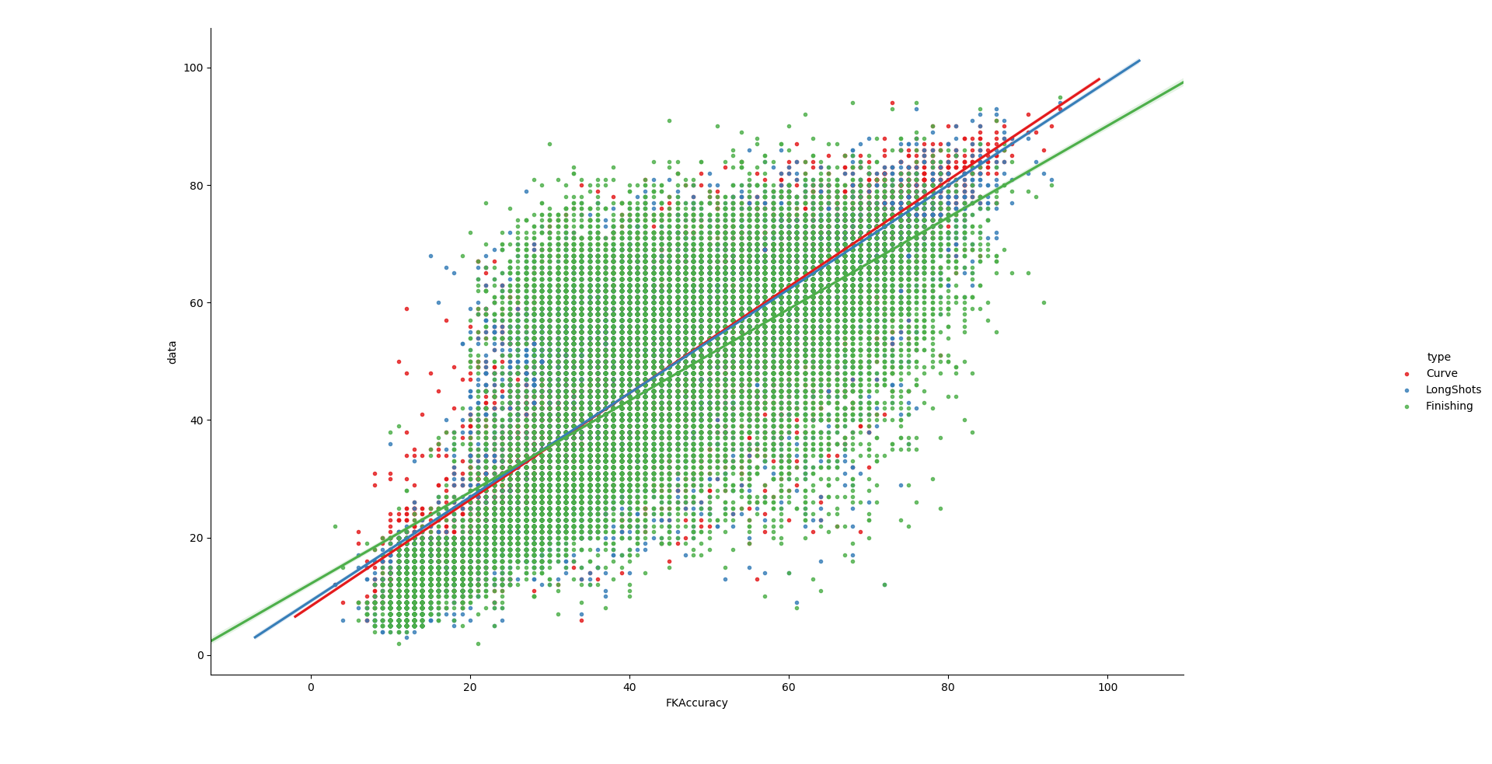
Decision Tree Algorithm
Making decision about Players Free Kick Accuracy
Free Kick Accuracy
Depends on Performance of
Curve
Finishing
Long Shots
as far as finishing performance increase
as far as Curve performance increase
as far as longshot performance increase
chances of
Free Kick become success increases
Free Kick power increases
vision of target increases
Chances of Goal
Increases
The Red dots representing the vision clarity, ORANGE dots representing the Power and GREEN dots representing chances of success of players while free kick is concerned. The green dots representing players who are equal in these 3 things cause In middle red and blue dots are overlapped by green ones, in graph players with green dots and having more than 60 FK Accuracy are eligible for taking free kick.
As the lines of Curve, Long Shots and Finishing represented in this graph the FK Accuracy highly depend on these 3 things.

Slide 8
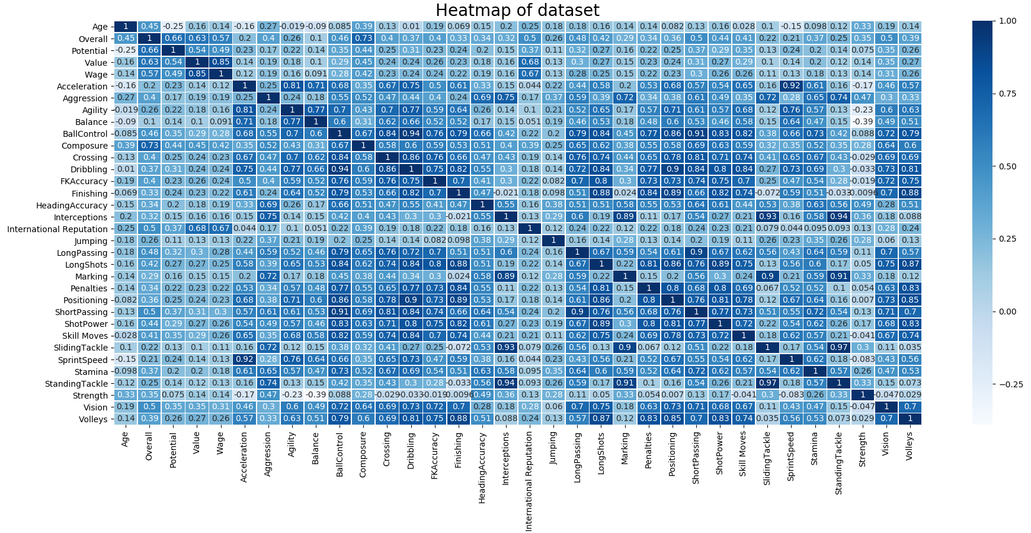
Heat-map: Correlation Analysis

Slide 9
Conclusion from Heat map
The above graph is represents the co-relation between each data in dataset.
Overall, it is related with composure, potential and value.
Potential is related with overall.
Value, it is related with Wage, International Reputation and overall.
Wage, it is related with value and international reputation.
Acceleration, it is depend on Sprint Speed and agility.
Aggression is related with interception.
Agility is related with acceleration.
Balance is related with agility very highly oppositely related with Strength.
BallControll is related with dribbling.
Composure is related with overall.
Crossing is related with dribbling and BallControll.
Dribbling is related with BallControll and Positioning.
Free Kick Accuracy is related with Longshots.
Finishing is related with Positioning.
Heading Accuracy is related with Aggression.
Interceptions are related with Tackle and Marking.
International Reputation is related with value and wage of player.
Long Passing is highly related with Short Passing
Long Shots is related with Shot Power.
Marking is related with Tackle and highly related with Standing Tackle.
Penalties related with shot power and finishing.
Positioning is related with dribbling and finishing, vision, volley, skill moves passing and shots.
Short Passing is related with Skill Moves and BallControll.
Shot Power related with Long Shot and Volley.
Skill Moves are related with composure and dribbling.
Tackles are related with Interception and player marking.
Stamina is related with shot power and sprint speed.
Vision is related with long shots, finishing and volleys.
Volley is related with finishing, shot power and penalties, vision.

Slide 10
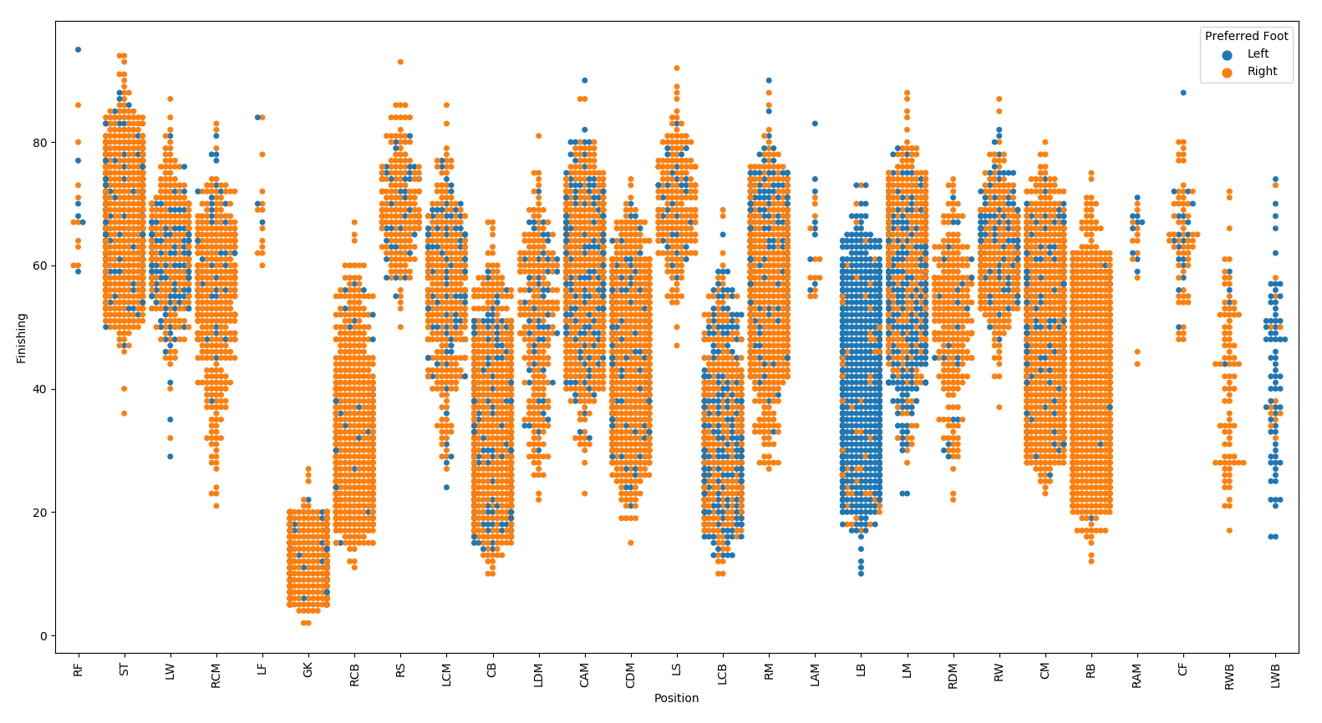
Swarm Graph – Position and Finishing
This graph shows that at left back position, maximum players are with left foot. ST position having righty players which are brilliant in finishing. All right forward players are good in finishing.

Slide 11
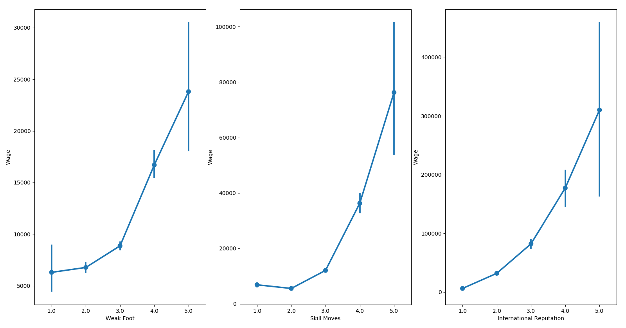
Factor Plots – Wage Diff. of Weak Foot, Skill Move and International Reputation
The relation of wage is depend on International Reputation of player, but at the level 5, weak foot, skill moves and international reputation having very large amount of difference in wage.

Slide 12
Conclusions
Total 18207 players, 48 players with unknown preferred foot, more than 76% of player are Right preferred foot.
There are 651 clubs in Fifa 19 but yet 241 players are not member of any club.
The age range of player is between 16 and 45, most of the player are in age class 20 to 30.
Total 164 nation's player are part of Fifa 19. The nation England, Germany, Spain are nation from maximum player are in Fifa 19, and Fiji, Nicaragua, Namibia are nation from minimum player are in Fifa 19. The maximum wage is paid by Spain, England and Brazil to their players. England having maximum clubs in Fifa. Portugal is having world’s best player Ronaldo.
Total 651 clubs are there from them minimum player count in club is 18 and maximum is 33 players. Maximum clubs having 28 players. If we see performance of club players Juveture is at 1st then it is Napoli, Inter, and Real Madrid. In Wage of player Real Madrid is at 1st then Barcelona, in investment vs performance of club Juveture is very smart. From all players in Fifa 1.32 % players which is near about 241 players haven't joined any club.
Total wage paid to all players is 177.1 Million Euros, in wage and performance L. Messi having similar performance to C. Ronaldo but L. Messi taking more wage then C. Ronaldo.
Skill Moves, maximum players having rating 2 and rating 3, Brazil and Spain having top skilled players. In clubs Liverpool, Lazio, Borussia Dortmund having most skilled players.
Most skilled nation in average of Skill Move is United Arab Emirates, Libya, Bermuda and so on. Most poor skilled player are from Belize, Oman and then Guatemala nation. Most poor in skill moves are player who haven't joined any club. 47 % players have rating 2 and 36 % players have rating 3 the improvement needed for them.
Face, only 9 % near about 1.6k players have real face other have no real face.
Body Type, Maximum player having normal body and very less players have stocky body type.

Slide 13
Positions, Total 27 different positions are there and maximum players playing at ST position, then GK and CB. Maximum wage is paid to ST positioned players near about 20M Euros.
Jersey Number, There are 1 to 99 Available jersey number players, and if we see number of players maximum player are having number 8, after 40 number very less players are there.
Total loaned players in Fifa 19 are 1264 and they are from 341 different clubs.
Atalanta club has loaned maximum players then after Sassuolo and then Juventus.
Maximum player joined in 2018 and the ratio starts growing very increasingly from year 2013. It means the speedy rise of awareness of fifa is started from 2013. As a graph shows ogive curve, it possible that next year will create new record of player join in fifa.
Contact Valid Till, a very large number of player’s contact is end in 2019 near about 5820 players, so in this year there will be very high demand of players, and if we see next that is 2021 which is second top demand year for players, and in previous year 2018 there was very less demand of players.
Week foot details represents the average performance of player maximum players are with level 3 in week foot it is near to average.
Maximum players age 20 – 26. Very less players of age 16 and range of 33-46. Maximum age of player in fifa is 45.
In height players are in range of 5.1 to 6.9 (ft. in.) height. The height histogram graph shows highest number of player in fifa are in height class 5.10 to 5.28 or 6.00 to 6.18.
Weight, min is 110lbs and max is 243lbs. A histogram shows maximum players having weight class 136.6 to 189.8.

Slide 14
Bibliography
Kaggle.com
For finding, downloading and support of Dataset.
proz.com/kudoz/english-to-french/sports-fitness-recreation/695698-list-of-abbreviations-football-positions.html
For finding the information of different position abbreviation of football.
Wikipedia.com
Information about Fifa.
lfd.uci.edu/~gohlke/pythonlibs/
For downloading python modules.

Slide 15

Thank you

